Slide 1

EverSuite Training
Part 2

Slide 2
This training course
Training Goals:
Getting familiar with everteam.core
Everteam.capture ( if we have time)

Slide 3
Agenda
Most Important servlets
How to submit data to the server in everteam
Application flow overview
Exercise

Slide 4
Product Overview – Servlets
Best Practices when creating a new servlet:
  You servlet should extends ESServlet
  Always define doGet() and doPost()
    doGet() method should call the doPost()
  In the doPost() method :
    Surround all your code inside the doPost() by try and catch
    You should always start by declaring a new clsParams object
    Doing the necessary checking (params.checkTemplate() && params.initParams())
    Define a finally block to close the clsParams object
Notes:
L’appel clsParams.close() permet de décrémenter un map des threads tomcat utilisés. Cette map est utilisée pour récupérer la session des utilisateurs en cours.
Il est impératif que le compteur des thread soit à jour car tomcat utilise un pool de thread.
Un id de thread peut être réutilisé et donc provoquer des mélanges de sessions.
Params.checktemplate(): for the use of CSTABLEFORMS

Slide 5
Product Overview – Servlets
Most Important Servlets:
  GetRecords: Search for records according to the parameters passed
    Return type: XML and it can redirect to another template if needed
  ShowPage: Search for records according to the parameters passed
    Return type: redirects the output to a template
  Modify: Insertion or modification of the data in an existing table
  Delete: delete records from a table
Notes:
GetRecords: The use of <params> block is only permitted when using GetRecords.
ShowPage: If your only purpose is to get records and display them in a grid for example , it is recommended to use ShowPage since it is lighter.
Modify: Used by Record.js to update one or multiple records (Mode=update)
Delete: example, Delete?DBName=dPortal&TableName=test&Code=23

Slide 6
Agenda
Most Important servlets
How to submit data to the server in everteam
Application flow overview
Exercise

Slide 7
Product Overview – Submit data to Server
We will divide this into two possible ways to send data to the server:
  Submitting a form
  Ajax Request

Slide 8
Product Overview – Submiting a form
Submit a form normally requires the following:
  Define the form attributes:
    method: POST or GET
    action: GetRecords (Your desired servlet)
  Sending all the information in the request body:
    By defining input type=“hidden”
  Doing JavaScript code to submit the form (or submit button):
    Filling the hidden inputs with the values
    Submit the form: frm.submit();
Notes:
GET: is used to request data from a specified resource.
Note that the query string (name/value pairs) is sent in the URL of a GET request.
POST: is used to send data to a server to create/update a resource.
The data sent to the server with POST is stored in the request body of the HTTP request
POST requests are never cached
POST requests do not remain in the browser history
POST requests have no restrictions on data length

Slide 9
Product Overview – Ajax Request
Ajax Request:
  For this example we will use JQuery library.
    All your code should be wrapped in a document.ready function
    Create your simple ajax call using “$.ajax”:
      Type: POST
      url: GetRecords?DBName=&TableName=
      datatype: html
      Success: display the result inside a div

Slide 10
Product Overview – Ajax vs Form
Main difference:
Ajax Request | Submit a Form
Data is sent in the background no Page refresh | Data is loaded in a new page in the browser -> Page Reloaded
Server Side handling is the same | Server Side handling is the same
Cannot download directly a file because of security issues | Can return a file and open it in a new page

Slide 11
Agenda
Most Important servlets
How to submit data to the server in everteam
Application flow overview
Exercise

Slide 12
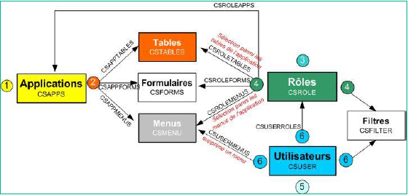
Product Overview – Application Flow

Slide 13
Agenda
Most Important servlets
Application flow overview
How to submit data to the server in everteam
Exercise
Notes:
Create your own application:
Create two tables
EMPLOYEES (CODE, NAME, ADDRESS, SESSIONUSER)
EMPLOYEE_DOCS(ID, EMPLOYEE_CODE, EMPLOYEE_NAME, DOCUMENT_TYPES, CV_DATE, CV_DESCRIPTION, HB_DESCRIPTION, PL_CODE)
Do the tables configuration.
Application Demonstration:
Knowledge to acquire:
Create Table
Create Application
Create Menus (Seach and Insert)
Create Users
Create Roles
Create Filters (data filtering)
Attribute rights
Doing the assignments (User and Roles , Roles and Menus ..)
Knowing the difference between Eversuite Vue and SQL View
TriggerManager: ( Records or on attachment)
Declared in CSPARAMS

Slide 14
Agenda
End of Second Day
Any questions?

